Slide 1
Computer Engineering 12 Class 23
Instructor: Yuhong Liu
Office: Bannan 324 F
Email: yhliu@scu.edu
Tel: 408-551-3513

Slide 2
Heap Sort
Is it stable?
78, 56, 32, 32, 8, 23, 45
Big O
Worst case: O(nlogn)
Best case: O(nlogn)
Average case: O(nlogn)

Slide 3
Shell Sort
An improved version of the insertion sort in which diminishing partitions are used to sort the data.

Slide 4
Review: Insertion Sort
i
last
Insertion Sort
 | ………….
sorted
Unsorted

Slide 5
Shell Sort
How does it work?
A list of N elements is divided into K segments, where K is known as the increment.
For each segment, do insertion sort.
Reduce the value of K and repeat the process, until K =1.

Slide 6
Demonstration
A[0]
A[1]
A[2]
A[3]
A[4]
A[5]
A[6]
A[7]
A[8]
A[9]
K=3
Segment 0
Segment 1
Segment 2

Slide 7
Example
Example:
77, 62, 14, 9, 30, 21, 80, 25, 70, 55
We set k = 5, 3, 1 progressively.

Slide 8
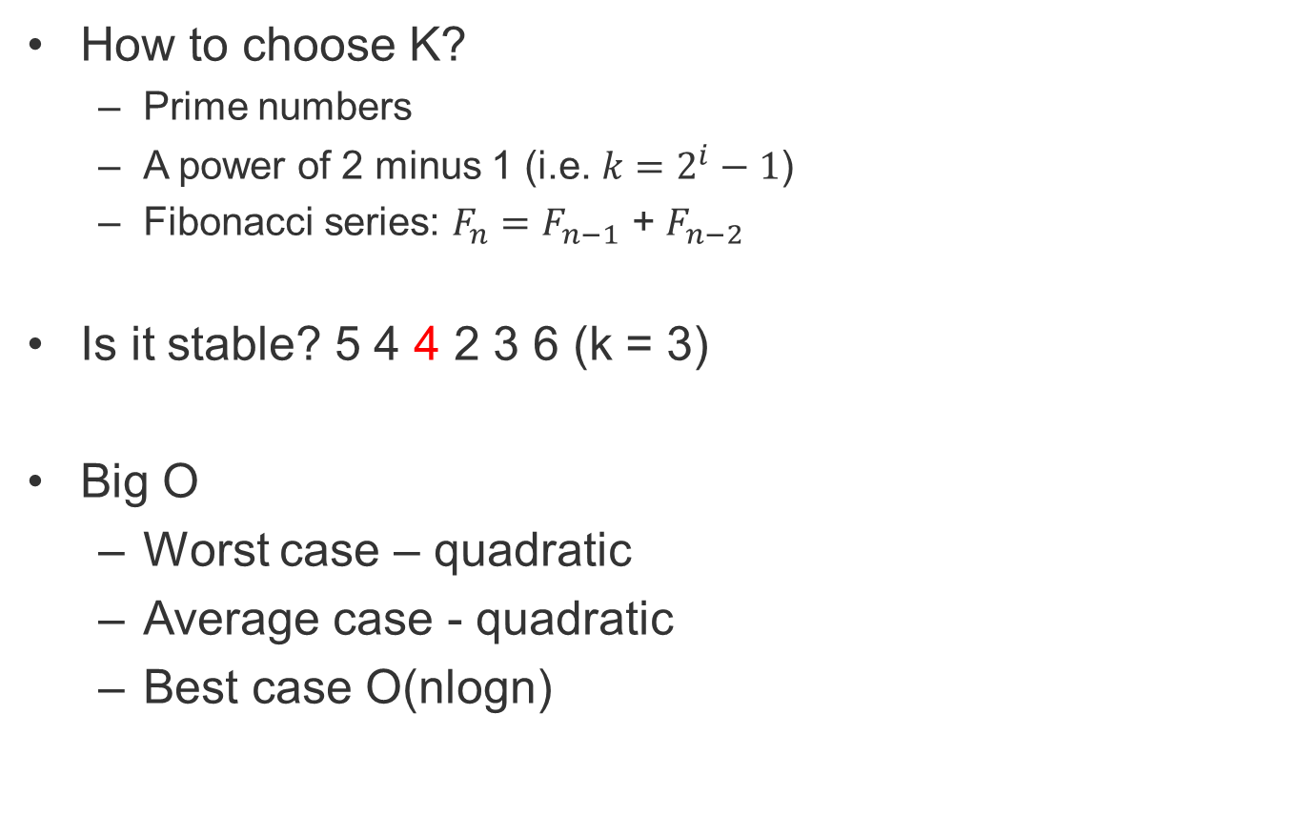
Shell Sort
How to choose K?
Prime numbers
A power of 2 minus 1 (i.e. $k=2^{i}−1$)
Fibonacci series: $F_{n}=F_{n−1}$ + $F_{n−2}$
Is it stable? 5 4 4 2 3 6 (k = 3)
Big O
Worst case – quadratic
Average case - quadratic
Best case O(nlogn)

Slide 9
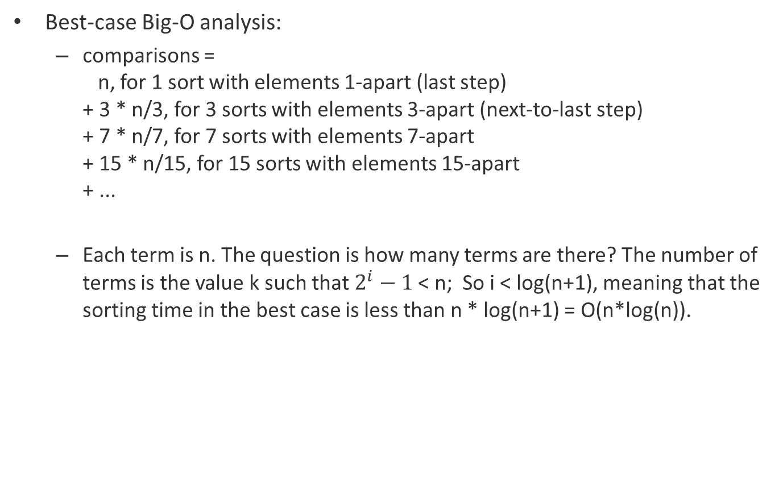
Additional Notes
Best-case Big-O analysis:
comparisons = n, for 1 sort with elements 1-apart (last step) + 3 * n/3, for 3 sorts with elements 3-apart (next-to-last step) + 7 * n/7, for 7 sorts with elements 7-apart + 15 * n/15, for 15 sorts with elements 15-apart + ...
Each term is n. The question is how many terms are there? The number of terms is the value k such that $2^{i}−1$ < n; So i < log(n+1), meaning that the sorting time in the best case is less than n * log(n+1) = O(n*log(n)).

Slide 10
Additional Notes
Worst-case Big-O analysis:
comparisons ≤ n², for 1 sort with elements 1-apart (last step) + 3 * (n/3)², for 3 sorts with elements 3-apart (next-to-last step) + 7 * (n/7)², for 7 sorts with elements 7-apart + 15 * (n/15)², for 15 sorts with elements 15-apart + ...
And so, with a bit of arithmetic, we can see that the number of comparisons is bounded by: n² * (1 + 1/3 + 1/7 + 1/15 + 1/31 + ...) < n² * (1 + 1/2 + 1/4 + 1/8 + 1/16 + ...) = n² * 2
The last step uses the sum of the geometric series.

Slide 11
Shell Sort
The method starts by sorting pairs of elements far apart from each other, then progressively reducing the gap between elements to be compared. Starting with far apart elements can move some out-of-place elements into position faster than a simple nearest neighbor exchange.
E.g. sort 4, 51, 70, 100, 200, 3, 50

Slide 12
Quick Sort
Another type of exchange based sorting algorithm.

Slide 13
Quick Sort Demonstration
After first partitioning
 | pivot1
Keys < pivot 1
Keys >= pivot 1
After second partitioning
 | pivot2 |  | pivot1
Keys < pivot 2
Keys >= pivot 2
…….

Slide 14
Quick Sort
How it works
Each time, selects an element, known as pivot.
Reorder the array so that all elements with values less than the pivot come before the pivot, while all elements with values greater than the pivot come after it (equal values can go either way). After this partitioning, the pivot is in its final position. This is called the partition operation.
Recursively apply the above steps to the sub-array of elements with smaller values and separately to the sub-array of elements with greater values.

Slide 15
Selection of Pivot
It’s important – affect Big O
How
Select the leftmost one
find the median (refer to textbook P562 – P564)
78 | 21 | 14 | 97 | 87 | 62 | 74 | 85 | 76 | 45 | 84 | 22
78 | 21 | 14 | 97 | 87 | 62 | 74 | 85 | 76 | 45 | 84 | 22
62 | 21 | 14 | 97 | 87 | 78 | 74 | 85 | 76 | 45 | 84 | 22
62 | 21 | 14 | 97 | 87 | 78 | 74 | 85 | 76 | 45 | 84 | 22
22 | 21 | 14 | 97 | 87 | 78 | 74 | 85 | 76 | 45 | 84 | 62
22 | 21 | 14 | 97 | 87 | 78 | 74 | 85 | 76 | 45 | 84 | 62
22 | 21 | 14 | 97 | 87 | 62 | 74 | 85 | 76 | 45 | 84 | 78
22 | 21 | 14 | 97 | 87 | 62 | 74 | 85 | 76 | 45 | 84 | 78

Slide 16
How to Place Pivot
62 | 21 | 14 | 97 | 87 | 22 | 74 | 85 | 76 | 45 | 84 | 78
pivot
Move from left to right : Looking for the element to place on the right of the pivot
Move from right to left : Looking for the element to place on the left of the pivot
Exchange them and move forward.
When the two walls meet, place the pivot in the middle.

Slide 17
Quick Sort
Example
62, 21, 14, 97, 87, 22, 74, 85, 76, 45, 84, 78

Slide 18
Quick Sort
Comparison with bubble sort
In bubble sort, consecutive items are compared and possibly exchanged on each pass through the list => more exchanges are required
In quick sort, a typical exchange involves elements that are far apart => fewer exchanges are required to correctly position an element.

Slide 19
Quick Sort
Big O analysis
Best case? – O(nlogn)
Average case? – O(nlogn)
Worst case? – O(n^2)
Stability?
Consider sequence 5 6 6 3 2

Slide 20
Summary
 | Best case | Average case | Worst case | Stability
Selection sort | O(n^2) | O(n^2) | O(n^2) | Depends
Heap sort | O(nlogn) | O(nlogn) | O(nlogn) | Not stable
Insertion sort | O(n) | O(n^2) | O(n^2) | Stable
Shell sort | O(nlogn) | Quadratic | Quadratic | Not stable
Bubble sort | O(n) | O(n^2) | O(n^2) | Stable
Quick sort | O(nlogn) | O(nlogn) | O(n^2) | Not stable
If “exchanges” only occur between two adjacent items, the sorting algorithm is stable.

Slide 21
Advanced Sorting - Radix Sort
What is Radix Sort?
radix sort sorts data with integer keys by grouping keys by the individual digits which share the same significant position and value. The sorting algorithm starts from the least significant digit and ends at the most significant digit of the largest value.
a non-comparative integer sorting algorithm
Example:
Sort 315, 313, 515, 124 in ascending order (smallest to largest)
See your notes for demonstration
Some questions:
Why do we start from the least significant digit?
How many iterations do we have?
For two keys with the same value at the current comparison digit, can we change their original order? Therefore, if we can group these keys in either a stack or a queue, which one should we use?
Radix Sort uses queues as its main structure

Slide 22
Radix Sort
In our project:
You use deques to build a series of queues, and do radix sort based on these queues.
We have non-negative integer inputs.

Slide 23
Demonstration
0
99
10
1
30
2
22
3
54
69
4
73
33
42
……
19
8
9

Slide 24
Demonstration
30
10
0
1
42
22
2
33
73
3
54
4
……
8
19
69
99
9

Slide 25
Demonstration
0
10
1
30
22
2
42
3
73
4
33
54
5
99
6
69
19
7
8
9

Slide 26
Demonstration
0
19
10
1
22
2
33
30
3
42
4
54
5
69
6
73
7
8
99
9

Slide 27
The Process
Save all the numbers in a queue (i.e. deque).
Take the least significant digit of each number.
Place each number based on its least significant digit into one of a series of queues (i.e. deques). For example, all numbers whose least significant digit is zero, will be placed in the “zero” queue (i.e. deque).
How many different values?
Besides the original deque, how many more deques do we need?
Once all numbers have been placed into their queues (i.e. deques), copy the numbers in the order they appear back into the original list.
Repeat the process using the next most significant digit until all digits have been processed.

